Slide 1
Clippers at two independent levels
ELECTRONIC DEVICES AND CIRCUITS
B . Gowthami, 23H55A7303

Slide 2
Definition : Two-level clippers are circuits that limit the positive and
negative peaks of a waveform to a specific voltage level.
Two-level clippers are electronic circuits used to limit the amplitude of a
waveform.
They consist of two diodes and are commonly used in signal processing applications.

Slide 3
Operation:
Two-level clippers use diodes to selectively allow or block portions of the input waveform.
When the input voltage exceeds the desired level, the diodes conduct and limit the waveform's amplitude.

Slide 4
Circuit Configuration:
Two-level clippers are typically implemented using a series connection of a diode and a resistor.
The diode conducts when the input voltage exceeds a certain threshold, limiting the waveform's amplitude.

Slide 5
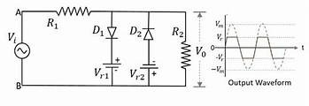
Circuit Diagram:

Slide 6
Applications:
Two-level clippers find applications in:
Audio processing
Communication systems
Instrumentation
They are used to protect circuits from voltage spikes, remove unwanted signal components, and shape waveforms.

Slide 7
Advantages:
Two-level clippers are simple to implement
cost-effective
can be easily integrated into various electronic systems.
They provide a straightforward solution for amplitude limiting requirements.

Slide 8
Limitations:
Two-level clippers can introduce distortion to the waveform due to the non-linear behavior of diodes. Additionally, they can only limit the peaks of the waveform and do not provide continuous amplitude control.

